Slide 1
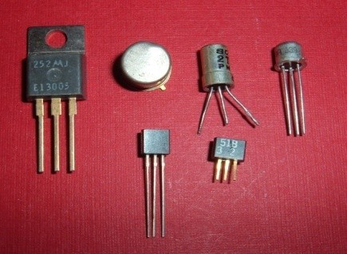
TRANSISTORS

Slide 2
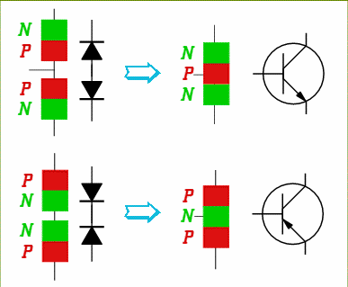
Invention of the Transistor
Bell Labs (1947): Bardeen, Brattain, and Shockley
Originally made of germanium
Current transistors made of doped silicon
NPN
PNP

Slide 3
Bipolar Junction Transistor (BJT)
BJT is a three terminal device consisting of either a p type semi-conductor or n-type semi-conductor sandwiched between opposite types.
2 TYPES OF TRANSISTORS
NPN
PNP

Slide 4
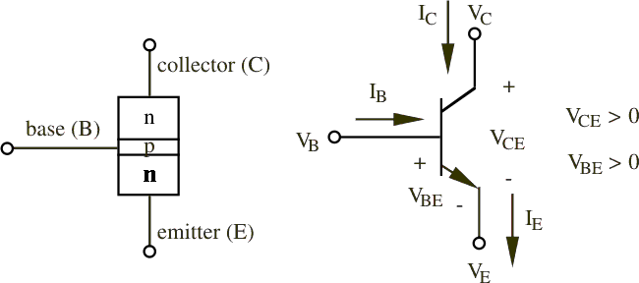
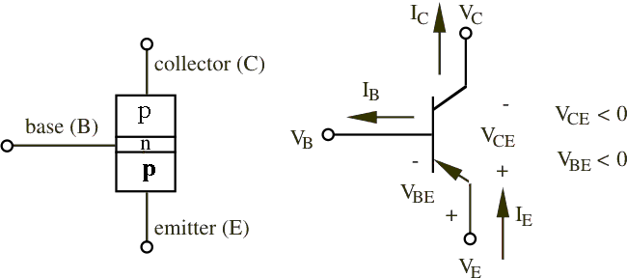
TYPES OF TRANSISTORS
NPN SYMBOL
PNP SYMBOL

Slide 5
TRANSISTOR REGIONS
EMITTER
Region to the left end
Most heavily doped Region
Terminal connected from this region is the emitter terminal
Function : To supply majority charge carriers
BASE
Centre region
Doping is least
Smallest of the 3 regions
The terminal taken out from this region is base terminal.
Function: Controls the movement of majority charge carriers from the emitter to the collector.

Slide 6
TRANSISTOR REGIONS Contd…..
COLLECTOR
Region to the right end
Moderately doped
Widest of the 3 regions
(maximum power is dissipated in this region)
The terminal taken out from this region is collector terminal
Function : Collects the majority charge carriers supplied by the emitter.

Slide 7
Transistor biasing
Transistor is made of two junctions.
EB-junction& CB-junction
Hence a transistor can be biased in 4 ways as:
EB & CB junctions both are forward biased
EB & CB junctions both are reverse biased
EB junction is forward biased &CB is reverse biased
EB junction is reverse biased &CB is forward biased
Best biasing technique is EB-Forward biased &CB-Reverse biased

Slide 8
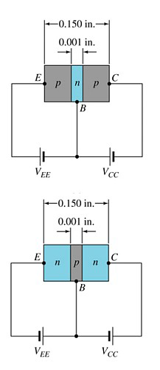
Transistor biasing contd….

Slide 9
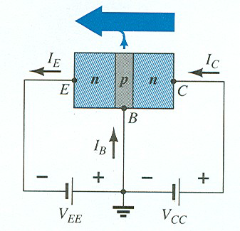
Transistor operation
With the external sources, VBE and VCB, connected as shown:
• The emitter-base junction is forward biased
• The base-collector junction is reverse biased

Slide 10
Transistor operation
CASE 1: UNBIASED TRANSISTOR
CASE 2: EB junction is opened, CB junction is reverse biased.
CASE 3: : EB junction is forward biased with CB junction is reverse biased.

Slide 11
Currents in a transistor
Emitter : I_{E} = I_{PE} + I_{NE} (largest (mA))
Base: I_{B} = I_{PE} + (I_{NE} – I_{NC})- I_{CBO} (very less(micro A))
Collector: I_{C} = I_{NC} + I_{CBO} (large (mA))
Emitter current is the sum of the collector and base currents:
I_{E} = I_{B} + I_{C}

Slide 12
TRANSISTOR CONFIGURATIONS
Depending on the Common terminal, there are 3 transistor configurations:
Common Base
Common Emitter
Common Collector

Slide 13
Transistor Characteristics
The characteristics is the graph between voltage and current variations plot
Transistors characteristics are categorised as,
1.CB mode characteristics
2.CC mode characteristics
3.CE mode characteristics
In each mode of transistors characteristics, the study of its input
characteristics & output characteristics is conducted.
• Input characteristics is, the graph between Input voltage
variations and the respective changes in the input current for
the constant control by output voltage
• Output characteristics is, the graph between Output voltage
variations and the respective changes in the Output current for
the constant control by input current

Slide 14
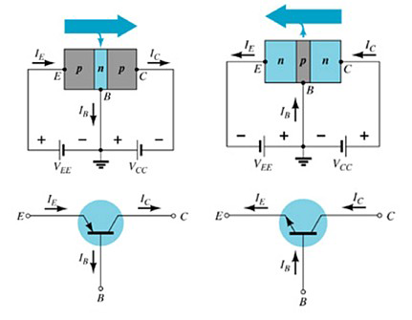
Common base configuration
The base is common to both input (emitter–base) and output
(collector–base) of the transistor.

Slide 15
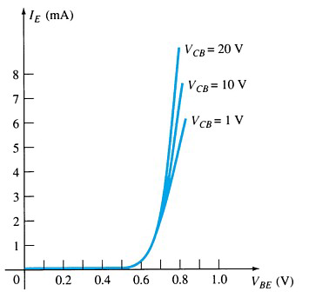
CB mode - Input Characteristics
This curve shows the relationship between of input current (IE)
to input voltage (VBE) for three output voltage (VCB) levels
Input Resistance (Rin) is the ratio of input voltage to the input current of the transistor for a constant value of output voltage.
i.e Rin = VEB/IE for a constant value of VCB

Slide 16
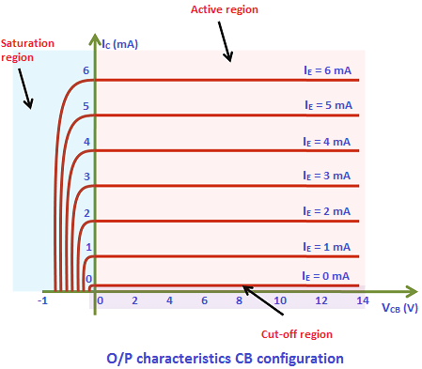
CB mode - Output Characteristics
Output Resistance (Rout) is the ratio of output voltage to the output current of the transistor for a constant value of input current.
i.e Rout = VCB/IC for a constant value of IE

Slide 17
OPERATING REGIONS
Active – Operating range of the amplifier.
Cutoff – The amplifier is basically off.
Saturation – The amplifier is ON

Slide 18
CURRENT GAIN – ALPHA
The current gain ‘α’ of a transistor in CB configuration is defined as the ratio of output current (Ic) to the input current (I_{E} )
Ideally, α is having value 1
In reality, it is between 0.95 and 0.998
α= Ic/ I_{E.}

Slide 19
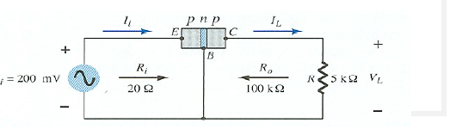
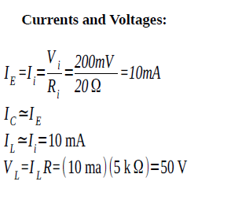
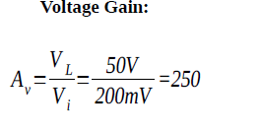
Transistor as an amplifier

Slide 20
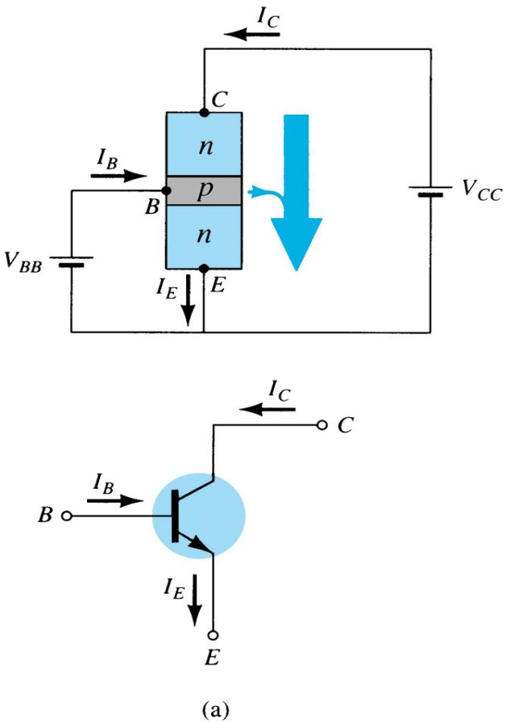
Transistor characteristics in CE mode
The emitter is common to both input (base emitter) and output (collector-emitter).
The input is on the base and the output is on the collector.

Slide 21
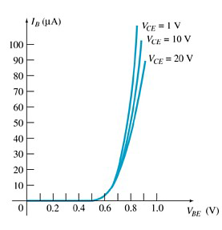
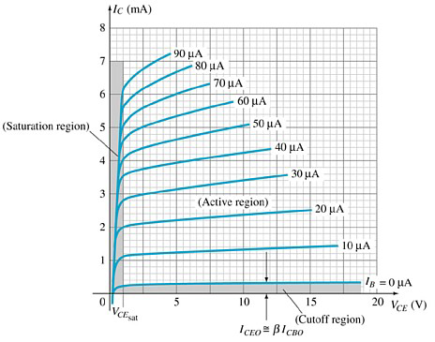
CE mode - Input & Output Characteristics

Slide 22
Common-Emitter Amplifier Currents
Ideal Currents:
I_{E} = I_{B} + I_{C}
I_{C} = α I_{E} + I_{CBO}
Actual Currents:
I_{E} = I_{B} + I_{C}
I_{C} = β I_{B} + (β+1) I_{CBO}
= β I_{B} + I_{CEO}

Slide 23
CURRENT GAIN – beta
The current gain ‘β’ of a transistor in CE configuration is defined as the ratio of change in collector current (Ic) to the base current (I_{B} ).
In reality, it is between 50 and 400
β= Ic/ I_{B.}

Slide 24
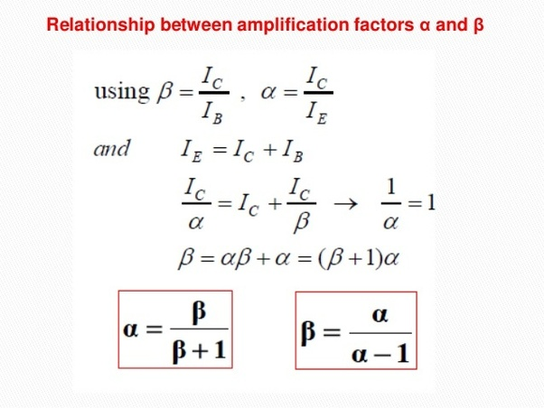

Slide 25
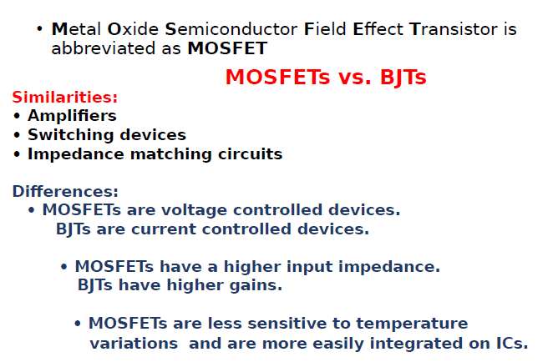
mosfet

Slide 26
Types of mosfet
MOSFET
Depletion Type Enhancement Type
N channel P channel N channel P channel

Slide 27
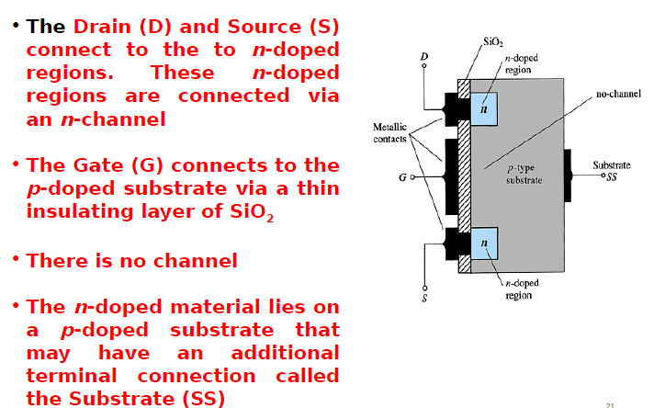
E- type mosfet construction

Slide 28
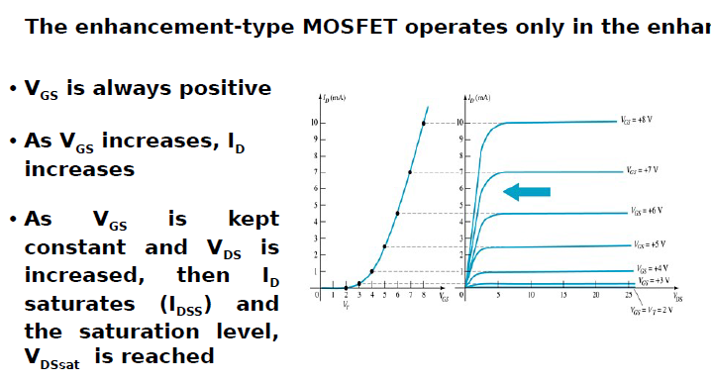
Basic operation of the e type mosfet

Slide 29
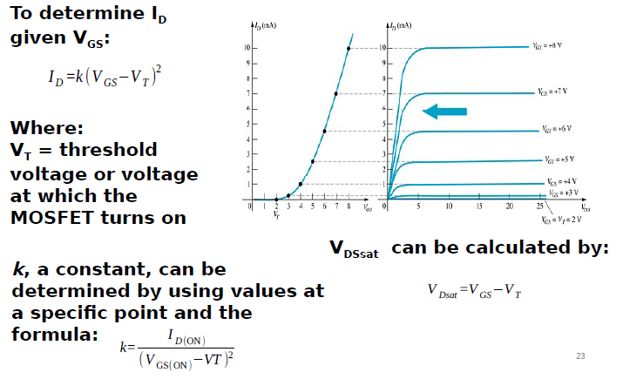
e type mosfet transfer curve

Slide 30
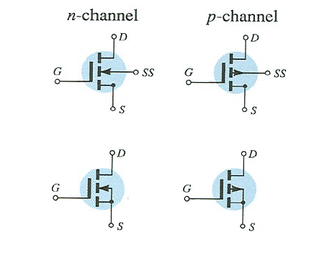
Mosfet symbols

